Slide 1
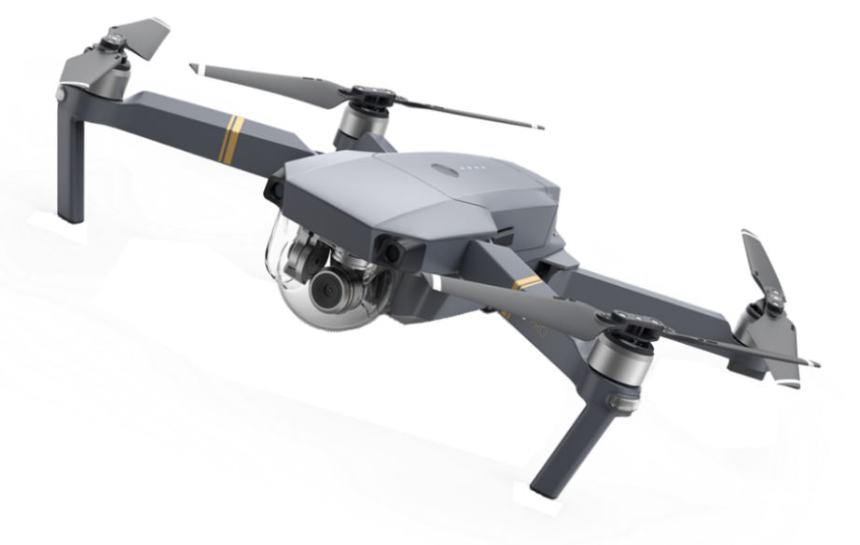

Remote UAV Attacks & Disruption of Their Operation
Common communication protocols
BASED ON
Unmanned Aerial Vehicles Networking Protocols
Security Analysis of the Drone Communication Protocol
Itay Ben Moshe

Slide 2
Introduction
UAV (Unmanned Aerial Vehicle) are used to support critical services such as forest fire and search and rescue operations, alongside amateur civic activity, which is sometimes disturbing.
For this purpose, UAV are often equipped with a navigation system, a camera, and they have a radio that enables wireless communication with the ground control station or a remote control.
However, the wireless communication channel opens up the door for several types of remote attacks
Itay Ben Moshe

Slide 3
Lack Of Security Mechanisms
There is lot of bidirectional communication between the drone and the base station.
Many different types of communication channels can be used for this like Wi-Fi, Bluetooth or Radio Channels.
The major problem with these communication channels is that they are used without any form of encryption or that they are used together with weak encryption that can be cracked
Itay Ben Moshe

Slide 4
Radio Frequency - RF
As it stands, RF communications are the most optimized solution for reliable drone communications systems. UAV communications systems typically operate on frequencies of 2.4/5.8 GHz.
To communicate with an UAV, many drone controllers use Wi-Fi which can be transmitted on the 2.4/5.8 GHz spectrum, and is something that smartphones and tablets can tap into without any accessories
UAV communications systems work by using one frequency to control the aerial vehicle from the ground via a remote pilot while the other frequency is used to beam data or relay video.
Itay Ben Moshe

Slide 5
DOS Attack (WiFi - based drones)
A number of packets sent to the controller or drone to separate the connection and allow the opportunity of a new device to connect and take place (Deauthentication Frame)
As we have previously implemented a DOS attack on a wireless router, which caused, among other things, the disconnection of users from it and the prevention of reconnection to it, a similar operation can be implemented on WIFI-based UAVs.
Itay Ben Moshe

Slide 6
GPS Spoofing
A GPS spoofing attack attempts to mislead the drone’s GPS receiver by broadcasting fake GPS signals while pretending to be a legitimate GPS signal sent by a satellite.
This attack can trick any device using GPS signals into changing its trajectory or make the device believe that it is at another location.
Note: In my experience, car thieves in Israel use this method
Itay Ben Moshe

Slide 7

MAVLink
The Micro Air Vehicle Communication Protocol (MAVLink Protocol) is a point-to point communication protocol that allows two entities to exchange information.
It is used for bidirectional communications between the drone and the base station, and according to the article, it will soon become a worldwide standard protocol
MAVLink is a part of the DroneCode project, governed by the Linux Foundation
Itay Ben Moshe

Slide 8
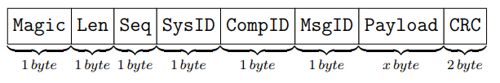
Structure of MAVLink message
A MAVLink message is sent bytewise over the communication channel followed by a checksum for error correction. If the checksum does not match, then it means that the message is corrupted and will be discarded
Brief description of some fields included in the message
Magic: indicates the beginning of a new messages.
Length: indicates the length of the payload field.
Sequence number: indicates the sequence number of the packet.
CRC : checksum for validation.
Itay Ben Moshe

Slide 9
Conclusion
There are various types of communication channels between a drone and its base station.
Our goal is to focus in a major and common communication channel, find it vulnerabilities and implement a tool that can disrupt and / or take over the UAV, using the protocols that the UAV uses for communication.
By doing it that we can also investigate and implement security and defense measures for these types of attacks.
Itay Ben Moshe

